Slide 1
Juice-perfect'-Unplanned downtime reduction
Raw material and Asset Management Analysis
APICS2112299

Slide 2
EXECUTIVE SUMMARY
Company’s Background
Current Situation and Problems
Possible Solutions
Produces Juices and Smoothies for three different bottling sizes and seven different fruits
Company wants to reduce the overall downtime by focusing on raw material management and asset management
Juice Perfect' , a California based juice manufacturing company has six different plants across USA
Excess ordering due to misplaced inventory, inventory not received in system etc.;57605 units of unmet production
Not enough bottles in the production line leading to substantial delay in production schedule
72.58% fill rate (spare parts availability) leading to delay in maintenance day schedule
Implementing RFID system for the raw materials inventory to properly locate it during planned production
Implementing improvement techniques such as Kaizen and advanced ERP for better communication in function groups
98% fill rate for the available spare parts so there are minimum stockouts; Reorder point of 100 units

Slide 3
COMPANY'S DESIRE AND PROBLEM STATEMENT
Company’s Needs
Problem Statement
Identifying pain points within filling/packaging line and recommend improvement strategies
Optimizing acquisition of packaging raw materials from vendor
Improving communication between different functional teams
Developing a robust strategy for asset management program
High unplanned downtime (hr.) for facilities in Florida and Georgia
Insufficient amount of raw materials in production line leading to excess ordering
132 days of delay in maintenance schedule which lead to significant effect on planned production
Notes:
Company’s Needs
Identifying pain points within filling/packaging line and recommend improvement strategies
Optimizing acquisition of packaging raw materials from vendor
Improving communication between different functional teams
Developing a robust strategy for asset management program

Slide 4
ASSUMPTIONS & JUSTIFICATION
While performing analysis all spare parts were assumed to be a single entity in order to have a common demand pattern
The required fill rate (service level) for the availability of spare parts was assumed to be 98%. The lead time for receiving the spare parts after placing an order is one week
The days delayed in maintenance due to unavailability of labor expertise was assumed to be one day per work order
The raw material inventory in the yard is not directly accessible unless and until it is stored into the warehouse

Slide 5
Minimizing Unplanned Production Downtime
Recommendation
Preferred downtime should be less than 10%
To improve the downtime for Florida facility (15%), company should invest on robust Computerized Maintenance Management System (CMMS)
Go for Proactive approach, not Reactive approach
Well-documented preventive/predictive maintenance schedule with high scheduled compliance
Kaizen principles of continuous improvement should be implemented

Slide 6
Raw Material Management Overview
Reasons left in yard | Sum of Amount left in Yard
Delay in Staging | 5890
Misplaced in Warehouse | 23940
Not received in system (Yard) | 16400
Others | 2575
Warehouse is full | 8800
Total | 57605
Notes:
The details about the reasons responsible for unmet production plan for one of the production line.
Between the time period of February to August, 49 times the given production line failed to match the planned production.
The total amount of unmet production is 57,605 units and there are in total 5 issues for unmet production which are listed in the graph
The most prominent issue among them is misplaced in warehouse, which happened 15 times and was responsible for unmet production of 23,940 units of products (42%).

Slide 7
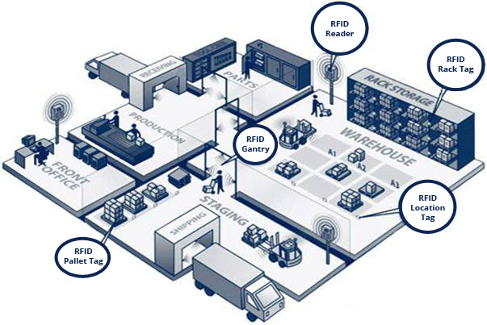
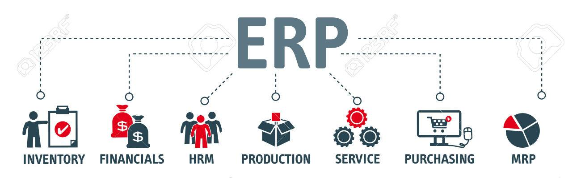
Recommendations for Raw Material Management
RFID (Radio-Frequency Identification)
Advanced ERP
Governs the major issue of misplaced Inventory in the warehouse
Eliminate the incidents of not recording the shipments in the yard management system
Increases visibility of the inventory and helps in keeping better track of the items
Improves the data integration so that the stored data is consistent, accurate and unique
Better collaboration and data sharing between different functional groups by providing interdepartmental database

Slide 8
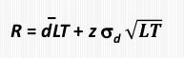
Asset Management Overview
Insufficient parts recommendation:​
Present service level (Z) of the parts required for maintenance schedule is 72.38%
The average parts needed (d̅) is 52 units/week
The purchase order for insufficient parts are placed before one week of maintenance day. Thus, lead time for the maintenance operation is one week
Purchase order is placed 1 week before maintenance day, thus lead time (LT) = 1 week
The standard deviation (σ_{d}) for parts required for maintenance is calculated to be 23.32 units/7 months
Reorder point (R) i.e. minimum number of inventory required for recommended service level of 98% is 100 units
Thus, the company will have sufficient maintenance inventory for 98% of time
Reference formula for Reorder point (R):

Slide 9

Recommendation for delays in maintenance work due to labor expertise:
Lack of labor expertise comprises 22% of total reasons responsible for delay in maintenance work
Implement the employee training program for mechanical work-related labor
For some of the critical tasks company should look for using contingent workers
Re-evaluating the recruiting practice by hiring workers with at least 80% of skillset matching the requirements.
Implement cross training program
Notes:
The major contribution amongst 3 types of labor work, the actual labor hours for mechanical work shows the highest amount of deviation from planned hours.

Slide 10

Additional Problems and Recommendations
Material Management
Warehouse is Full
Capital investment to expand the storage area
Online-based cloud management software
Delay in Staging
Improve Material Requirement Planning (MRP)
Reason Left in Yard
Recommended Solutions
Notes:
online-based cloud management software can bring greater accuracy and transparency to your entire warehouse operation.

Slide 11
Additional Problems and Recommendations
Asset Management
Labor Shortage
Implementing attendance reward programs
Providing comfortable working environment
Delay Reasons
Recommended Solutions
Conclusion
By implementing (s,S) policy reorder point, excess spare parts in inventory can be reduced in order to store more raw materials
By hiring workers with at least 80% of skillset matching the requirements, we will be able to reduce the increased labor hours due to lack of labor expertise
After successful implementation of these recommendations in one production line, Juice Perfect' can implement these recommendations in all of its manufacturing plant

